Slide 1
Notes:
Hello everyone and welcome to today’s webinar training on Controlling Healthcare Costs.
My name is Jason Eisenhut and I work in the human resources department at Employco.
We provide outsourced payroll, human resources and benefits services to a variety of small and mid-size employers.
Today’s training will likely take about 25 minutes depending on how many questions we get at the end of the webinar.
Ok, let’s get started.

Slide 2
Topics for today’s session
Healthcare cost trends
Reasons behind medical plan premium increases
Strategies to control costs
Open enrollment tips

Slide 3
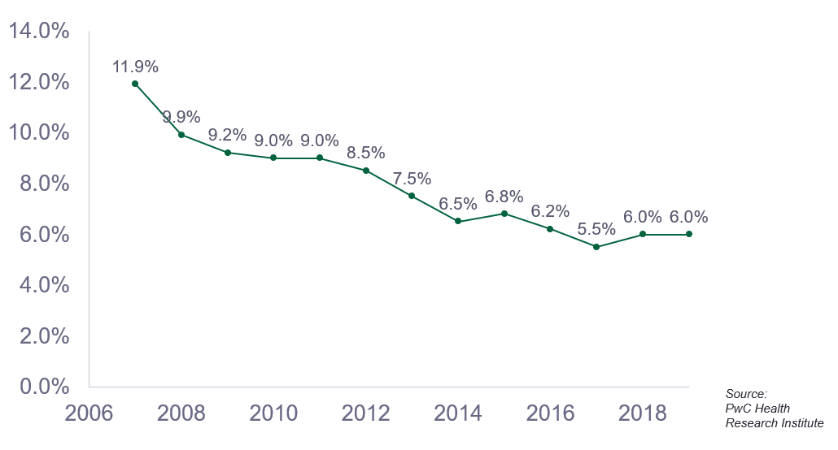
HEALTHCARE COST TRENDS

Slide 4
Reasons behind medical PLAN premium increases
Normal inflation
Increased Rx costs
Demographics and health
Government regulation
Consumer demand
New medical technology

Slide 5
COST CONTROL STRATEGIES
Premium shift to employees
Claim cost share shift to employees
Consumer Directed Health Plan (CDHP)
Wellness programs

Slide 6
COST CONTROL STRATEGIES (CON’T)
Spousal surcharge
Dependent eligibility audit
Telehealth or virtual office visit
Member education

Slide 7
OPEN ENROLLMENT TIPS VIDEO
Notes:
Over the next couple minutes, we’ll look at 4 examples of interview questions. At the end of each of the 4 video clips, we’ll wait for several seconds for you to guess if the interview question is legal or illegal.
Let’s start with the first interview example.

Slide 8
KEY POINTS TO REMEMBER
Healthcare cost trend has slowed down, but it’s outpacing general inflation
Cost increases are affected by a variety of factors
Employers have several options to control costs
Annual open enrollment is a great time review strategy and re-educate your employees and their dependents

Slide 9
Notes:
That concludes today’s webinar. At this time, we’ll open it up for any questions.
If you don’t have any questions at this point or think of a question later, please feel free to contact me using the phone number or email address shown on the screen.
Thank you everyone. Good bye.

